Slide 1
Typesetting with T_{E}X / L^{A}T_{E}X
Part III: Basic Mathematics

Slide 2

Mathematics

Slide 3
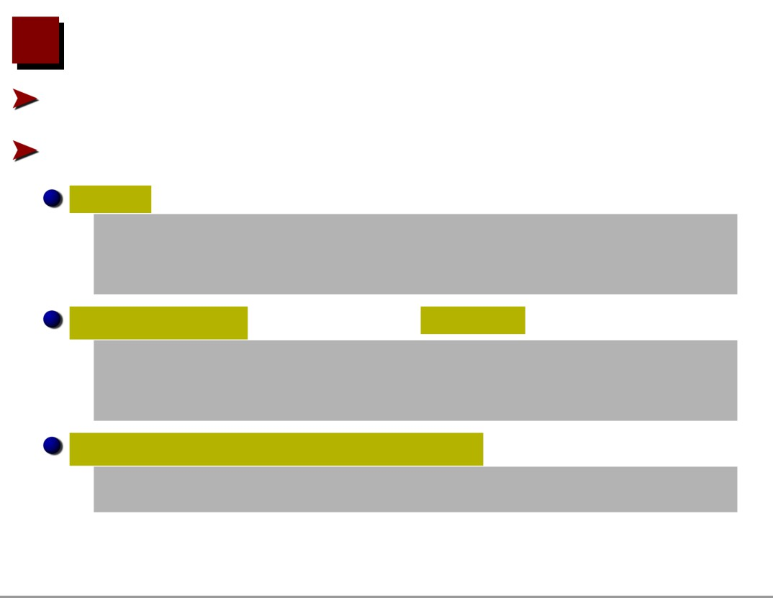
Basic Mathematics
EX/LATEXusesaspecialmodefortypesettingmathematics Different versions of formula environments
T
In-line maths for formula in text:
\begin{math} ...
\end{math}
\( ...
\)
$ ...
$
Display maths as separated one-line formula:
\begin{displaymath} ...
\end{displaymath}
\[ ...
\]
$$ ...
$$
Numbered one-line display maths formula:
\begin{equation} ...
\end{equation}

Slide 4

Simple Maths Examples
In-line maths:
Let $x$ be an integer, s.t.\ \( x = 2n + 1\)
Let x be an integer, s.t. x = 2n + 1
Display maths: We have
We have
$$ f(x) = 4x + 1$$
f (x) = 4x + 1
Numbered display maths: \begin{equation}
g(x) = (x-1) / 4 \end{equation}
g(x) = (x − 1)/4 (1)

Slide 5

Subscripts and Superscripts
Subscripts are created by:
{sub-script}
Superscripts are created by: ^{super-script}
Sub-/Super-scripts can be nested and grouped
Example:
$$a l = b k c^k j + d {x^l} +
{f l}^t$$
al = bl
t
kcj
+dxl + fl

Slide 6

Fractions and Square Roots
Fractions are produced using:
\frac{numerator}{denominator}
Roots are produced using: \sqrt[n]{formula}
Example:
$$\frac{\sqrt{2 +
√
z^2}}{\sqrt[3]{a} + 5}$$
2+z2
3
√a+5

Slide 7

Greek Letters and Special Functions
Greek letters are produced by \ followed by letter name: $\alpha, \beta, \Gamma,α,β,Γ,ϵ,ε,τ
\epsilon, \varepsilon,
\tau$
Special functions can be produced using commands like \log, \sin, \exp
$\exp (i\theta) = \cos exp(iθ) = cos θ + i sin θ \theta + i \sin \theta$
Two versions of modulus function
$a \bmod b$,
a mod b, i (mod j)
$i \pmod{j}$

Slide 8

Summations, Products, Limits
Summations and products:
\sum {low}^{high}
\prod {low}^{high}
Limits:
\lim {limit}
$$
\lim {\theta\rightarrow \pi}
∑
lim θi sinθ
θ→π
i=1
\sum {i=1}^{n}
\theta^i\sin \theta $$

Slide 9
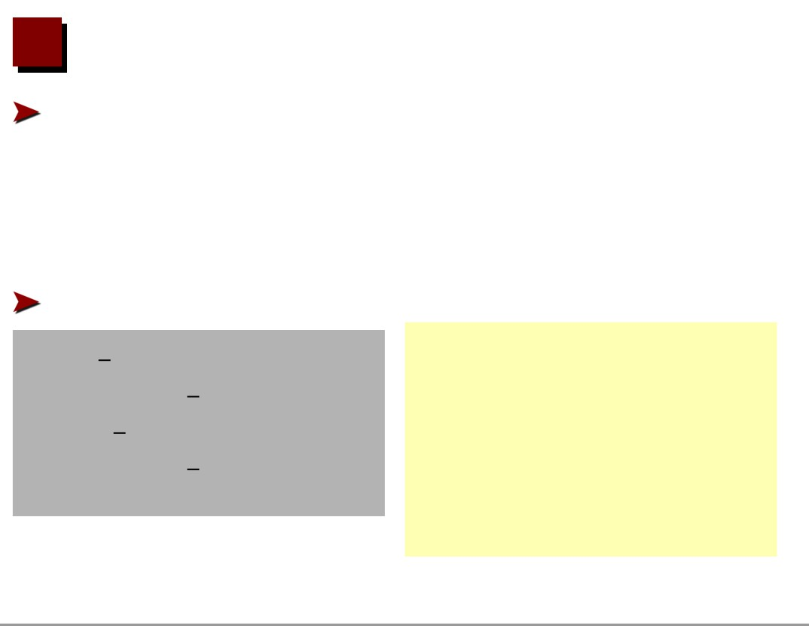
More Summation Like Symbols
Commands to produce variable size summation like sym- bols:
\int
integral
\oint
circular integral
\bigcup big union
\bigcap big intersec.
\coprod coproduct . . .
Note difference between inline and display style:
∫b
$\lim {b\to limb→∞ \infty}\int a^b f(x)$
a f(x)
∫
$$\lim {b\to
b
lim
f (x)
\infty}\int a^b f(x)$$
b→∞
a

Slide 10
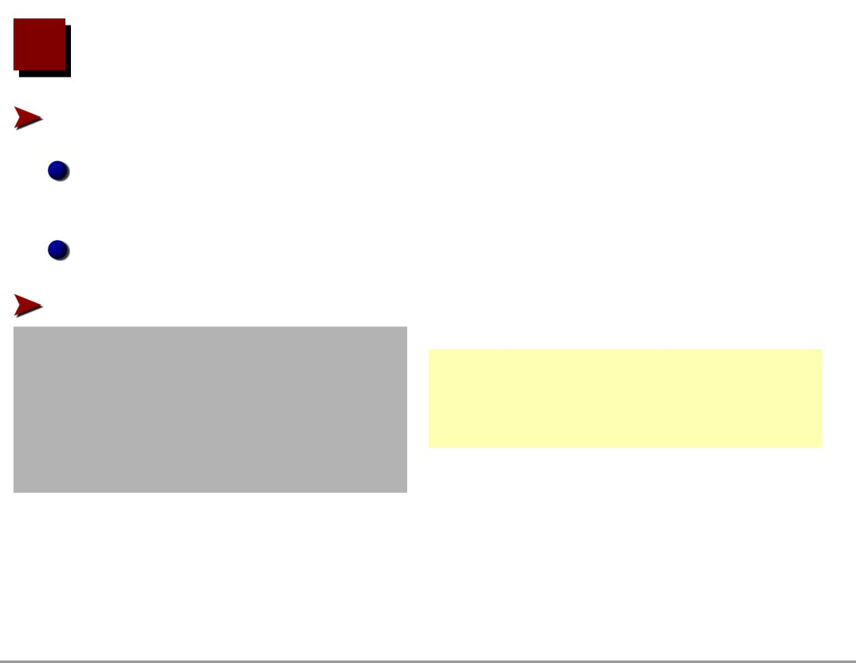
Arrays
To typeset arrays use array environment
Elements are arranged in rows and columns for vectors, matrices, different cases, . . .
Similar to tabular environment, but inside maths mode A plain array:
$$\begin{array}{cc}
0 & 1\\
0 1 23
2 & 3
\end{array}$$

Slide 11

Matrices and Vectors
Use delimiters to get brackets, etc. $$\left(
\begin{array}{cc}
0 & 1\\
2 & 3
\end{array}
\right)\left[ \begin{array}{cc}
4 & 5\\
6 & 7
\end{array} \right\}$$
( 0 1)[ 4 5}
2
3
6
7

Slide 12
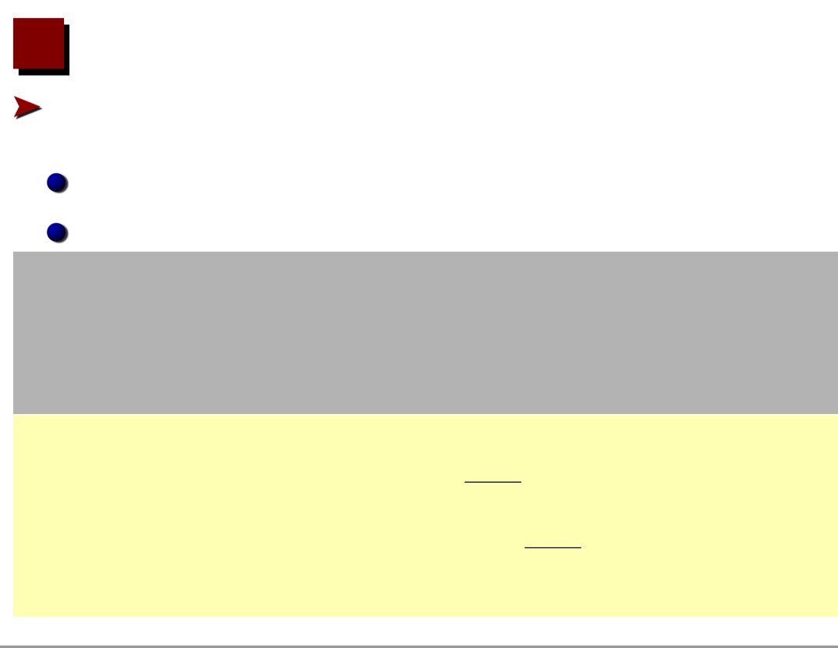
Multiline Formulæ
Use the eqnarray environment for multiple aligned equa- tions
Works similar to array with three fixed columns: rcl eqnarray numbers each line
\begin{eqnarray}
\ln (f(x)) & = & x^2 + \frac{1}{x + 3}\\
f(x) & = & \exp \left (x^2 + \frac{1}{x + 3}\right) \end{eqnarray}
1
ln(f (x)) = x2 +
(2)
x+3
(
1
)
f (x) = exp x2 +
(3)
x+3

Slide 13

Unnumbered Multiline Formulæ
Use \nonumber to suppress line numbering in eqnarray for a single line
\begin{eqnarray}
\ln (f(x)) & = & x^2 + \frac{1}{x + 3} \nonumber\\ f(x) & = & \exp \left (x^2 + \frac{1}{x + 3}\right) \end{eqnarray}
1
ln(f (x)) = x2 +
x+3
(
1
)
f (x) = exp x2 +
(4)
x+3
Use \eqnarray* environment for unnumbered multi-line for- mula

Slide 14

Symbols, etc.
Many additional symbols available in maths mode
\approx
≈
\neq
=
\leq
≤
\geq
≥
\partial
∂
\pm
±
\cdots
···
\vdots
.
.
.
\ddots
.
.
.
\longleftarrow
←−
\Longleftarrow
⇐=
\rightarrow
→
\mapsto
→
\aleph
ℵ
\forall
∀
\exists
∃
\cup
∪
\cap
∩
\setminus
\
\times
×
\Leftarrow
⇐
\equiv
≡
see literature. . .
\leftarrow
←

